Slide 1

ADOBE
ILLUSTRATOR
GROUP MEMBERS:
ASHMAL ANIS
19K-0305
ABDUL SAMAD
19K-1396
HASNAIN SOMANI
19K-0204

Slide 2

Table of content :
Introduction and history on Adobe Illustrator
Uses of Illustrator
Functions
Interface
Features
Tools
References
End

Slide 3


Slide 4
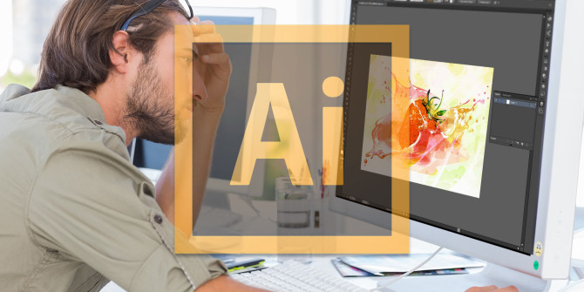
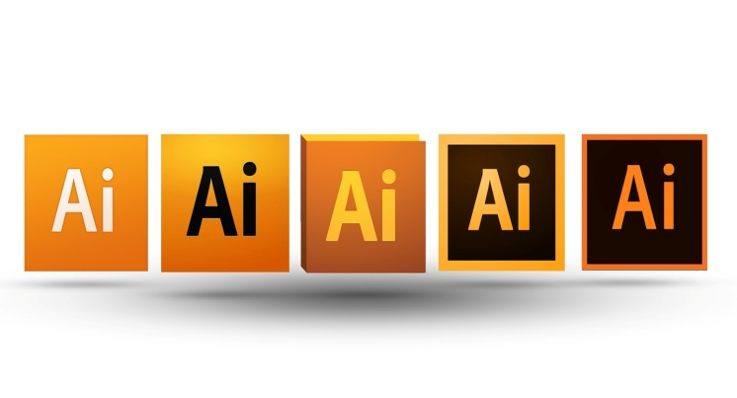
History of adobe illustrator :
Illustrator, Adobe's first software application, was released in 1987. Among its most significant features was its pen tool, which enabled the user to draw smooth curves and create high-resolution shapes and images. Through the years, Illustrator continued to expand, adding support for more-complex drawing tools, an ever increasing number of drawing “layers” (which can be quickly undone), and support for three-dimensional figures. In addition, the company improved usability through greater convergence of its user interfaces for its various programs.

Slide 5
What is illustrator ?
Illustrator is a vector drawing program.
It is used to draw illustrations, cartoons, diagrams, charts and logos.
Unlike bitmap images that store information in a grid of dots, Illustrator uses mathematical equations to draw out the shapes.
This makes vector graphics scalable without the loss of resolution.

Slide 6
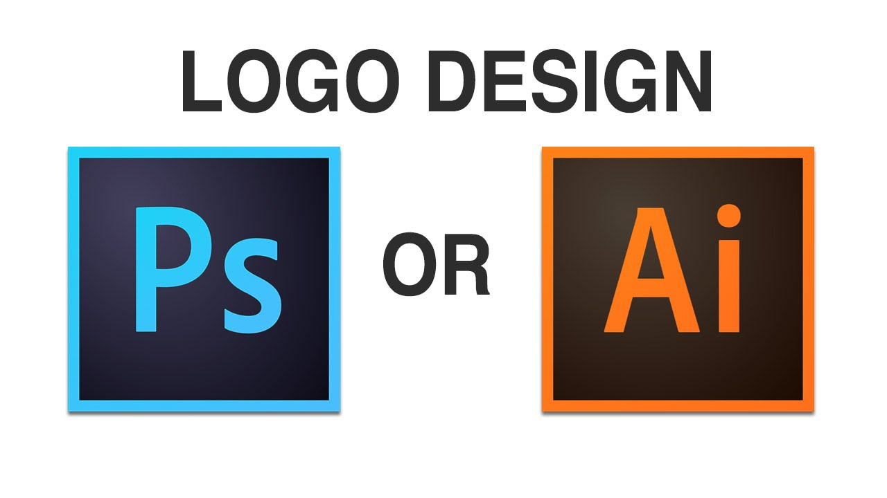
Why illustrator?

Slide 7
Why illustrator ?
The difference in strengths between Photoshop and Illustrator became clear with the rise of the Internet, Illustrator was enhanced to support Web publishing, rasterization previewing, PDF, and SVG (Scalable Vector Graphics.)
Illustrator released by Adobe, is available for both the Mac OS X and Microsoft Windows operating systems, making it one of the most used and recommended software used for vector image forming and editing.

Slide 8

Tools of illustrator ?
In Illustrator, the tools are broadly organized in the following categories :
Draw
Type
Paint
Modify
Navigate

Slide 9
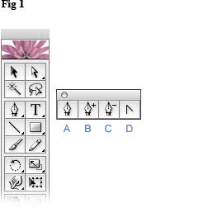
The draw tool
Understand what the drawing tools create
All of the drawing tools create paths. Paths come in the form of a closed path like a square or circle, or an open path like a line. All paths—closed or open—are made up of anchor points, which control the direction and shape of the path, and line segments (or paths) that connect those anchor points.
Draw tool consists of several options such as:
Paintbrush tool
Blob Brush tool
Pencil tool
Curvature tool
Pen tool

Slide 10
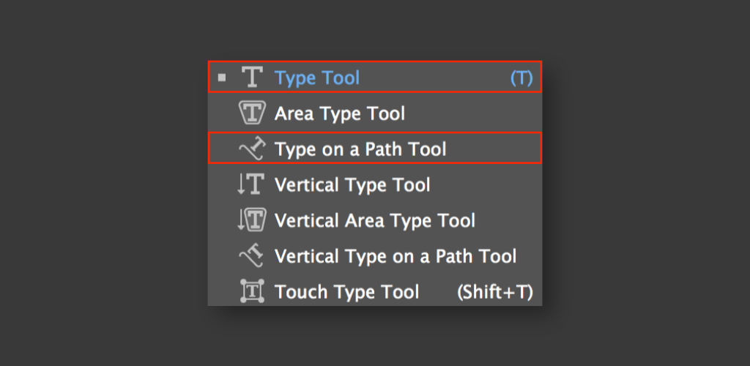
The type tool
The type tool is used to add text to your document. Just click on the type tool in the tool bar, click anywhere on the artboard and add text to your project. Furthermore, alterations to size, fonts and designs of the font can be made. Shapes and colors may also be given to the text to make it more attractive.

Slide 11
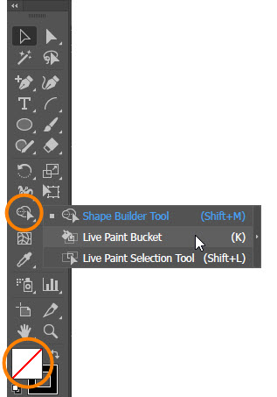
The PAINT tool
The live paint bucket tool allows you to group together edges and faces in convenient ways. Double-click the desktop icon for Adobe Illustrator to launch it, or click “Start,” “All Programs,” and "Adobe Illustrator." Click the “Path” tool, and draw a figure to which you wish to apply different fill or stroke colors.

Slide 12
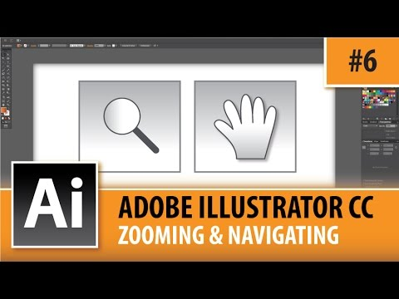
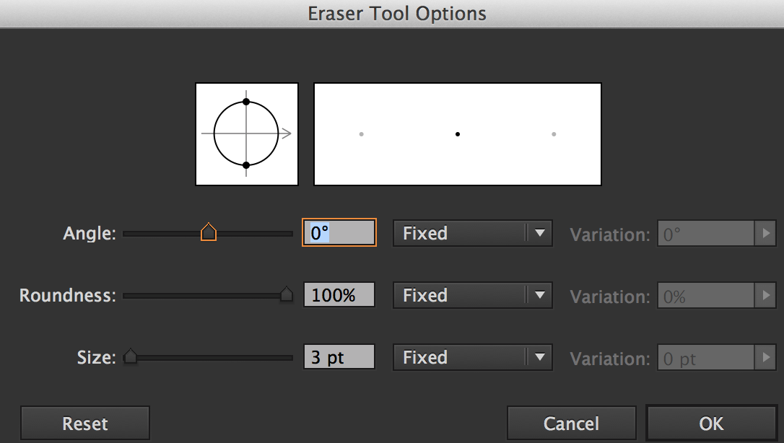
The modify and navigate tool :
These are basically Shape editing tools which allow the user to change the shape with the help of anchor points, changing their sizes and dimensions, and customize your shape according to your wish. In short, both of these tools are entirely different but have the same motive.
Modify Tool
Navigation Tool

Slide 13
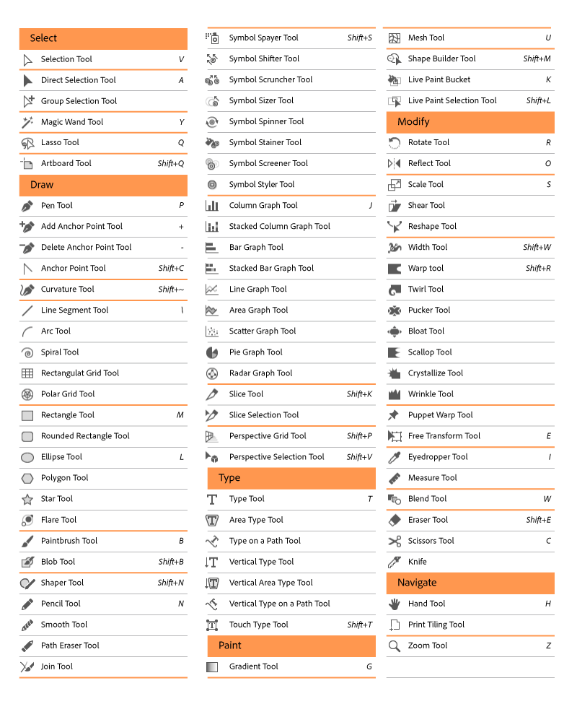
IN A NUTSHELL:

Slide 14
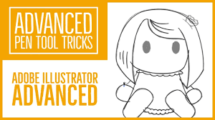
Moving towards advanced tools

Slide 15
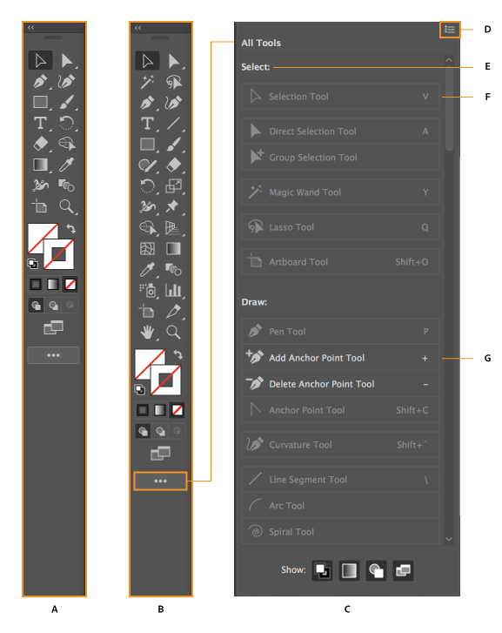
A. Basic toolbar
B. Advanced toolbar
C. All Tools drawer
D. Flyout menu
E. Tool category
F. Tool available in
the toolbar
G. Tool available in
the drawer

Slide 16
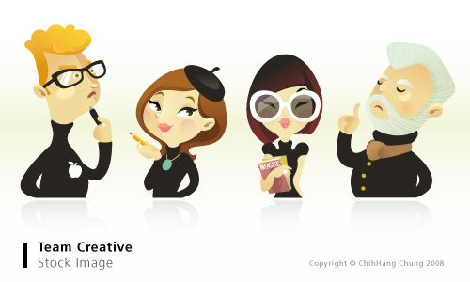
Common uses OF ILLUSTRATOR

Slide 17
How adobe illustrator is used ?
Adobe Illustrator is used to create a variety of digital and printed images, including cartoons, charts, diagrams, graphs, logos, and illustrations.
Illustrator’s ability to place text around a curve is especially useful for artists creating logos.
Illustrator also makes it possible to manipulate text in many ways, making Illustrator a useful tool for creating postcards, posters, and other visual designs which use text and images together.
Illustrator allows a user to import a photograph and use it as a guide to trace an object in the photograph.

Slide 18
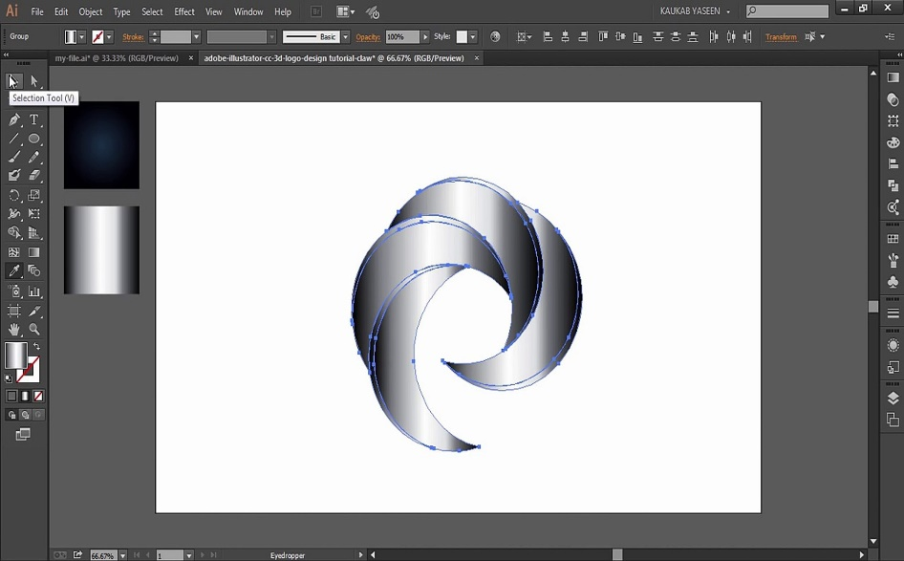
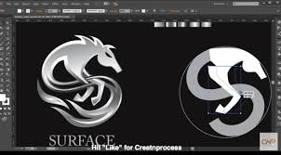
Common uses of illustrator :
Designing Logos

Slide 19
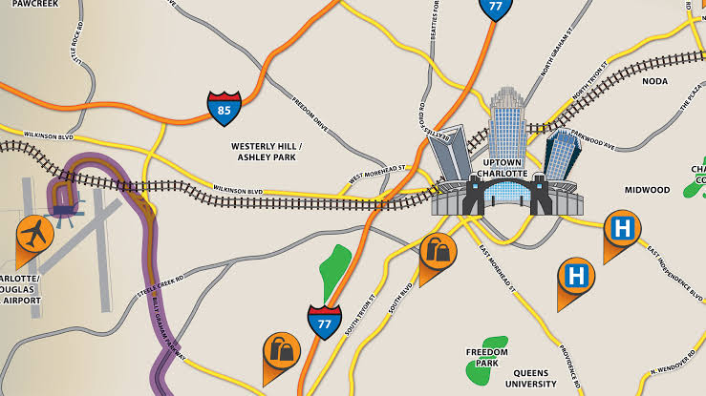
Common uses of illustrator :
2. Drawing maps.

Slide 20
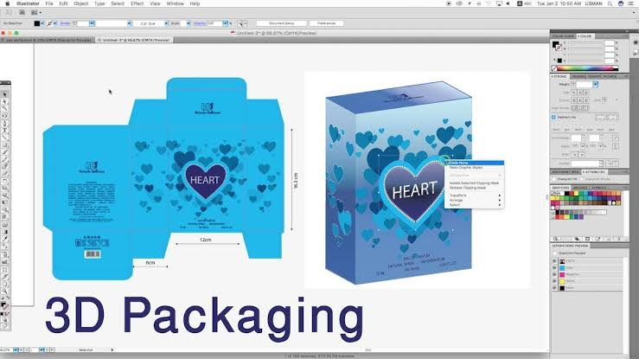
Common uses of illustrator :
3. Packaging designs.

Slide 21
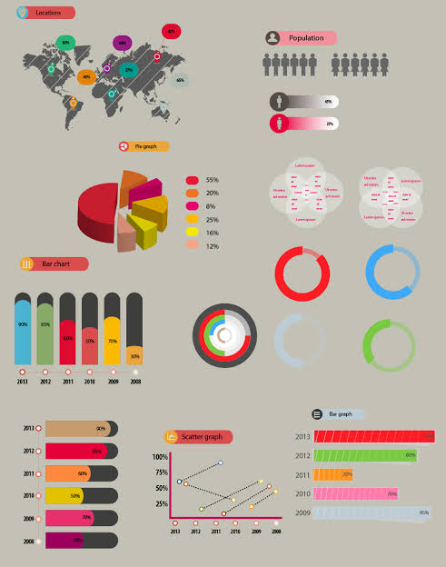
Common uses of illustrator :
4. Info graphics

Slide 22
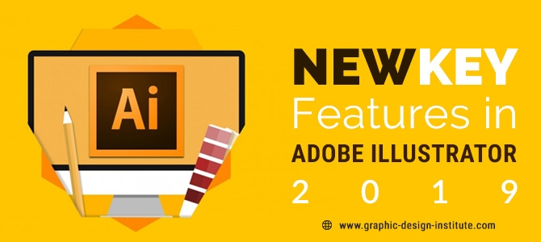
FEATURES OF ILLUSTRATOR

Slide 23
KEY FEATURES :
Cloud libraries
Touch type tool
Images in brushes
Font search
Multiple file place
Color syncing
Sync settings
Edit once, update everywhere
Fast zoom and magnification
Content filtering
File management
Image library
Data import/export
Image editing
Projections

Slide 24
Cloud libraries :
A Creative Cloud library is a centralized location for storing design items that you may re-use across different Creative Cloud applications such as Photoshop, Illustrator, and InDesign
TOUCH-type tool :
It is an intuitive way to adjust the scaling, position and rotation of individual characters in text, saving you from expanding the text to outlines or messing about for ages in the Character Panel

Slide 25
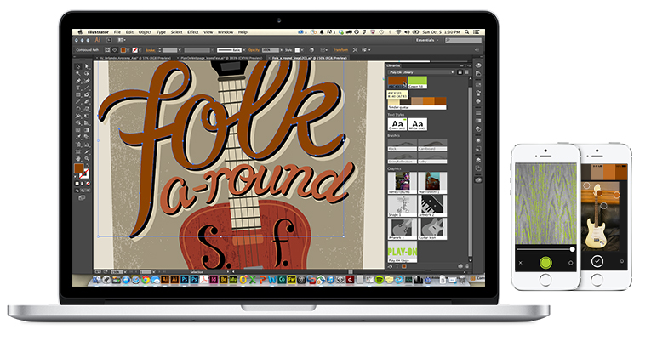
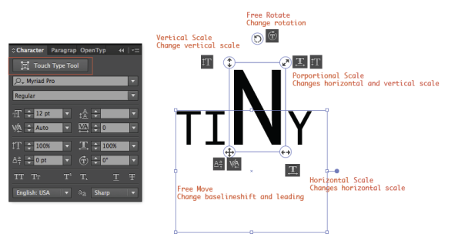
Cloud Libraries
Touch-Type Tools

Slide 26
IMAGE IN BRUSHES :
Brushes let you stylize the appearance of paths. You can apply brush strokes to existing paths, or you can use the Paintbrush tool to draw a path and apply a brush stroke simultaneously.
FONT SEARCH
You can browse thousands of fonts from hundreds of type foundries from within Illustrator, activate them instantly, and use them in your artwork that are available in all Creative Cloud applications. Browse the font list and select the font you want.

Slide 27
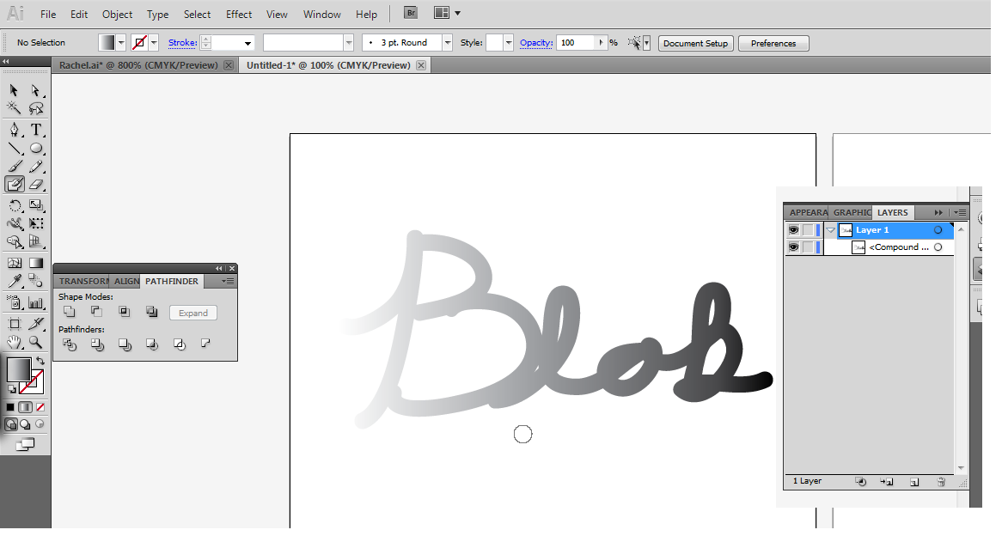
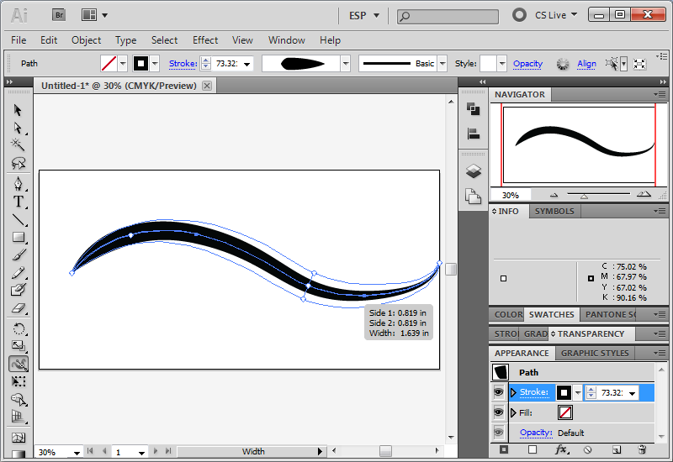
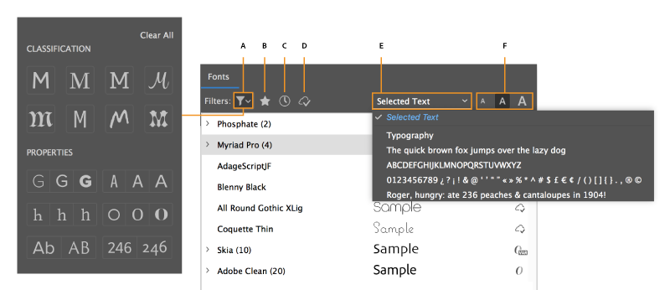
Image in brushes
Font Search

Slide 28
Multiple file space :
Place multiple files at a time Open an Illustrator file that you want to place external files in, The Import Options dialog box is displayed for assets that have import settings in Illustrator.
Color syncing :
Color syncing allows us to keep colors consistent and ensures that the colors look same in all. It can also be useful as a means to back up your settings.

Slide 29
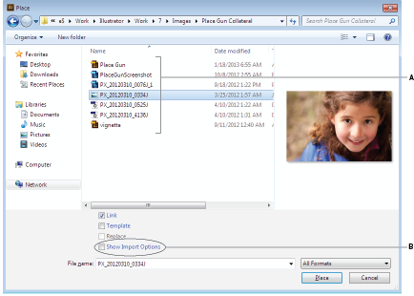

Multiple file search
Color Synching

Slide 30
Fast zoom and magnification :
Zoom tool: Using the zoom tool, you can click the Document window to zoom in; to zoom out. The pointer becomes a magnifying glass with a plus sign in its center. Pixels become more visible.
Image editing :
Illustrator features the feature of image editing. You can expand, change, manipulate, update, resize, customize the picture through illustrator.

Slide 31
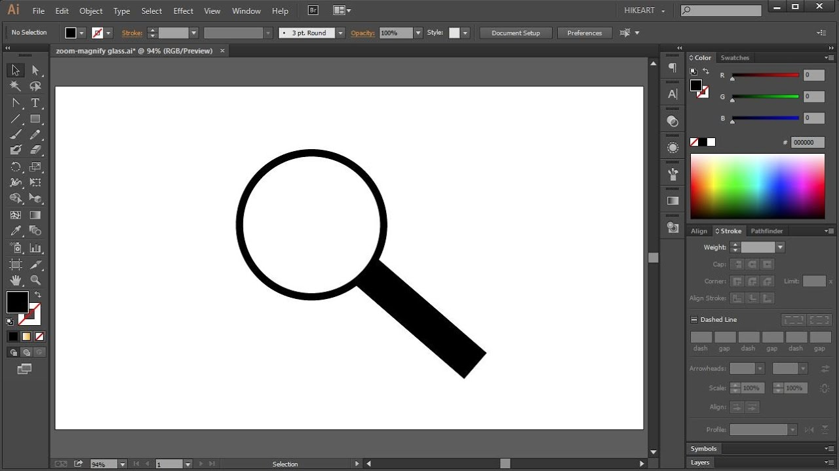
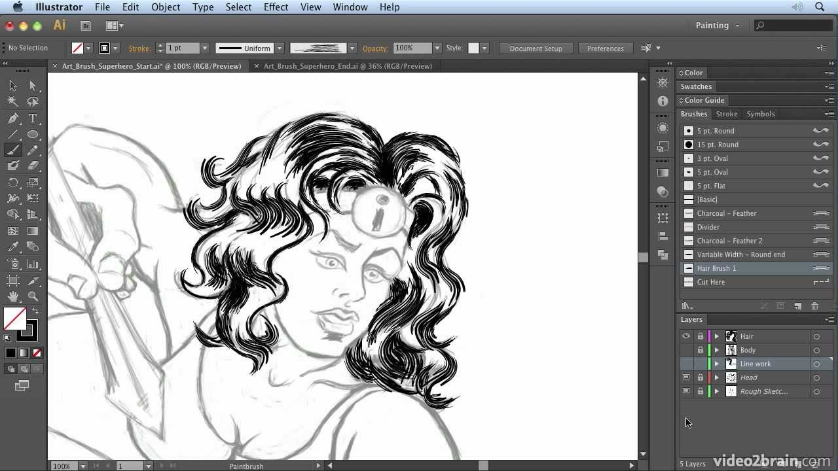
Fast zoom and magnification
Image creating and editing

Slide 32
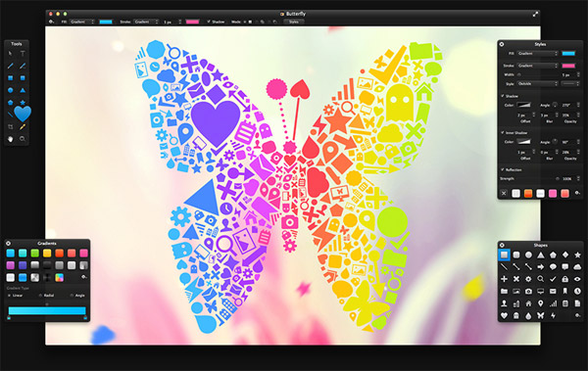
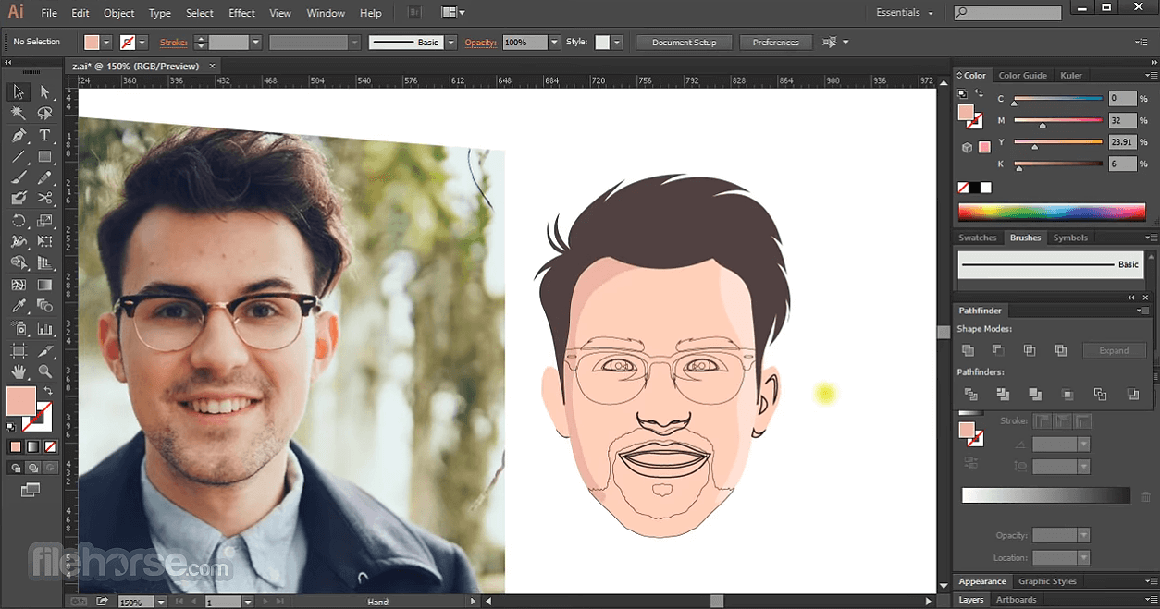

Slide 33
REFERENCES :
https://www.youtube.com/watch?v=51PrK8a8VcQ
https://www.google.com/search?q=history+of+adobe+illustrator&source=lnms&sa=X&ved=0ahUKEwjFhIuk6fblAhUESxUIHSqPDoMQ_AUIDSgA&biw=1024&bih=608&dpr=1
https://helpx.adobe.com/illustrator/using/tools.html
https://helpx.adobe.com/illustrator/how-to/drawing-tools-in-illustrator.html
https://visihow.com/Use_Type_Tool_in_Adobe_Illustrator
https://helpx.adobe.com/illustrator/using/live-shapes.html
http://www.graphic-design-institute.com/blogs/new-key-features-adobe-illustrator-2019
https://www.google.com/search?q=image+editing+in+illustrator&source=lnms&sa=X&ved=0ahUKEwjSj--WnPflAhVkqHEKHSevAiUQ_AUIDSgA&biw=1707&bih=720&dpr=0.8

Slide 34

NOOO, RIGHT?

Slide 35


